Slide 1
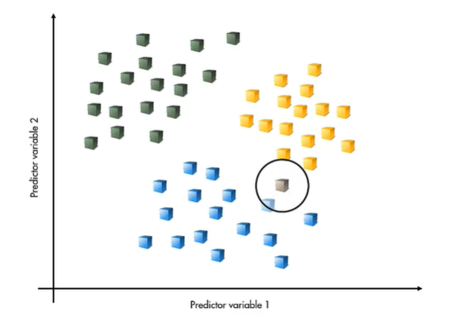
Nearest Neighbor Classifier

Slide 2
What is Nearest Neighbor Classifier?
One of the most straightforward ways of classifying a new observation is to look for the closest known observation and to assign the new observation to the same category as the nearest neighbor
When using this method, we do not have to make any assumptions about the underlying distribution of the data
Notes:
Introduction to Nearest Neighbor Classifier

Slide 3
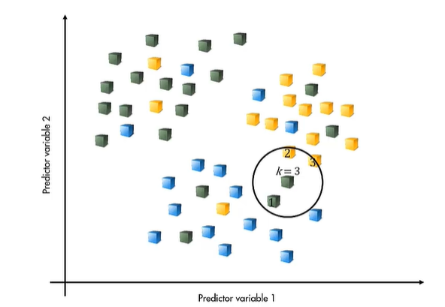
K-Nearest Neighbor Classification
This approach is very sensitive to the known data
If the nearest neighbor is an outlier the new observation is likely to be misclassified.
A simple way to avoid this problem is to look at more neighbors (k) and to use the majority class of the k-nearest neighbors to make the classification
Notes:
Nearest Neighbor Classifier with outliers

